Slide 1
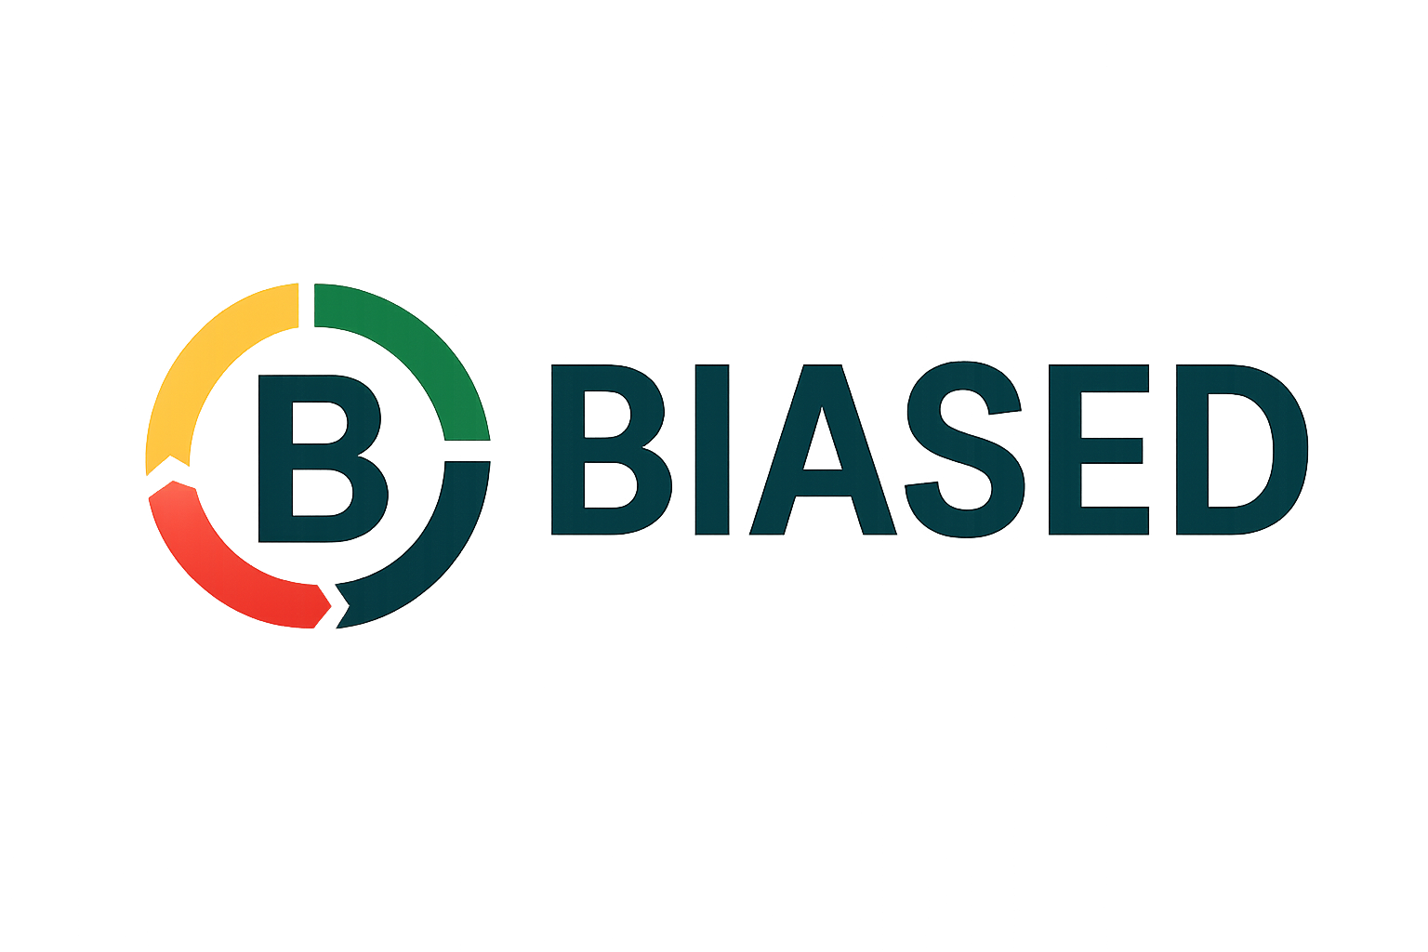
Business Intent. Aligned Systems. Engineering. Design.

Slide 2
Legacy agile techniques and frameworks are no longer sufficient
Insurance company using Scrum →
built a perfect AI system →
40% hallucination rate in production → adjusters stopped using it.
Notes:
A report by RAND Corporation indicates that “more than 80 percent of AI projects fail” — roughly double the rate of non-AI IT projects. RAND Corporation+2WorkOS+2
Another source puts the figure that between 70 % and 85 % of generative-AI deployment efforts fail to meet desired ROI. NTT DATA
A recent blog citing a Massachusetts Institute of Technology (MIT) study claims that up to 95 % of Gen-AI pilot projects fail to deliver measurable business impact. Forbes+1
Additional data: The share of firms that scrapped most of their AI initiatives rose to ~42% this year (up from ~17% the previous year). CIO Dive

Slide 3







Today’s frameworks allow you to execute well and still fail
Developers can’t explain why a user would care.
Leadership thinks Product Management equals writing tickets.
Domain experts say, “This is not what I meant.”
Security, Compliance, and Governance are an afterthought.
Notes:
The customer became the backlog. Not the Human.

Slide 4
BIASED
Organizations need a more opinionated approach to leading the entire Product Lifecycle.
Most SDLC Frameworks live here
Onboarding
& Training
Communications
Development
Operations
Compliance
Governance
Security
Sales
CI/CD

Slide 5
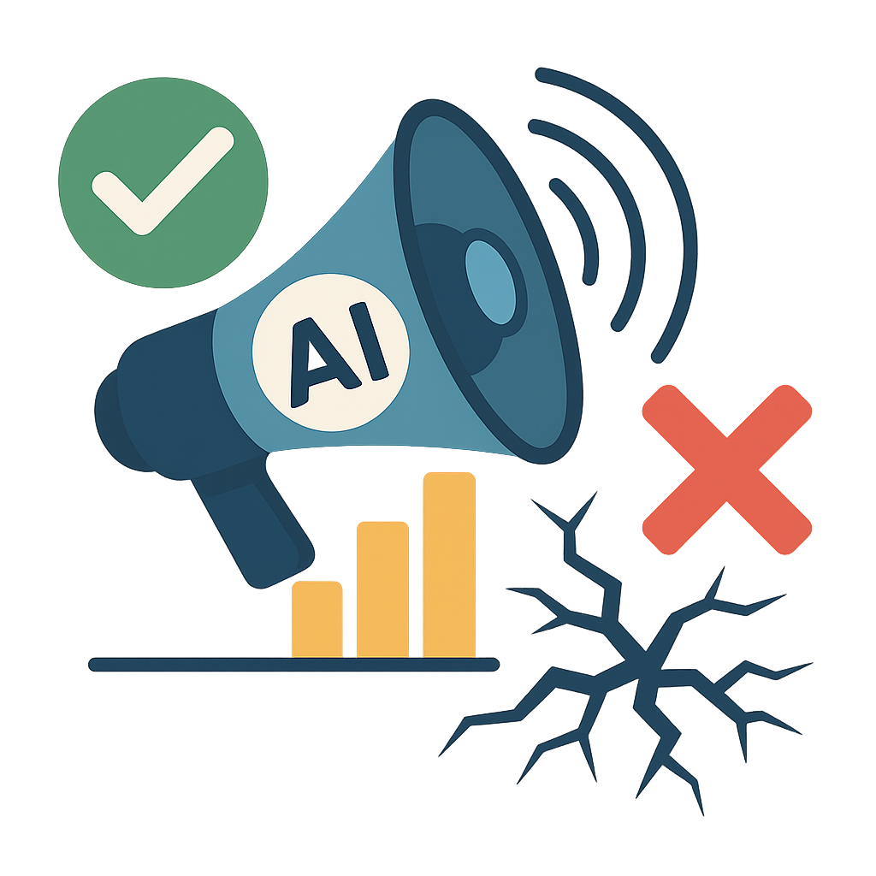
Agile frameworks like Scrum and SAFe already fail to manage the complete software development lifecycle properly.
AI lowers the floor, enabling fantastic demos, but it raises the ceiling for production-grade software.
Your agile practices break with AI.
Notes:
AI will amplify the issues in development teams due to organizations working on the same product are working in silos
Without intent, you can not use AI
Without good data, you can use AI
Without measurable human interactions, you’re just guessing. Fast development will mean you need to fail in production a lot
Without a strong platform, MLOps, and testing practices, you will fail fast.

Slide 6
Business Intent defines outcome that matter.
Aligned Strategy defines behavior that aligns to value.
Engineering architects, test and measures infrastructure and code.
Design defines outcomes and measurements to prove our intent.

Slide 7
Area | Traditional Agile/SAFe | BIASED | What You Unlock
Focus | Features | Behaviors | Products that act with purpose
Requirements | User Stories | Intent + Behavior Specs | Teams know WHY before HOW
Testing | QA at end | Continuous Evaluation | AI drift caught before customers see it
Data | Afterthought | Engineering asset | Predictable AI behavior
Governance | Last-mile approval | By design, in the loop | Safer, faster releases
Adoption | Training deck | Engineered change leadership | People actually use it
Leadership style | Servant | Directed, outcome-owned | Someone accountable for trust

Slide 8
Where legacy agile practices fail
Servant Leaders aren’t accountable for delivering value.
Your customer has become the backlog, not the human.
Small iterations can’t promise a timeline, making delivery uncertain.
Metrics like velocity and story points don’t scale and provide no value.
Deadlines are missed because security, governance, and operations are treated as afterthoughts.
Testing only during development will guarantee your AI projects fail due to drift.
Not properly managing data is causing delays in development, surprises in production, and AI projects to fail quickly.
BIASED exposes issues immediately, enabling leadership to act before problems occur

Slide 9






BIASED
Team Responsibilities
Team Leader
Project Management, Change Management, Training, and Adoption
Engineers
Developers, Data Engineers, Platform Engineers, Evaluation Engineers
Technical Domain Experts
Intent, Domain Experts, Governance & Policy, Subject Matter Experts,
Prompt Engineers

Slide 10

INTENT
Agile User Story: "As a user, I want to summarize a PDF so I can read it faster." (This executes code).
Acceptance Criteria: Is a summary of the PDF, including name, risk score, etc.
BIASED Intent Statement: "The system must summarize PDFs without omitting financial risk clauses, maintaining a neutral tone, and flagging uncertainty."
(The team is aware of intent and is empowered to resolve ambiguous issues. AI compares intent to security and governance policies alerting the team immediately.)

Slide 11
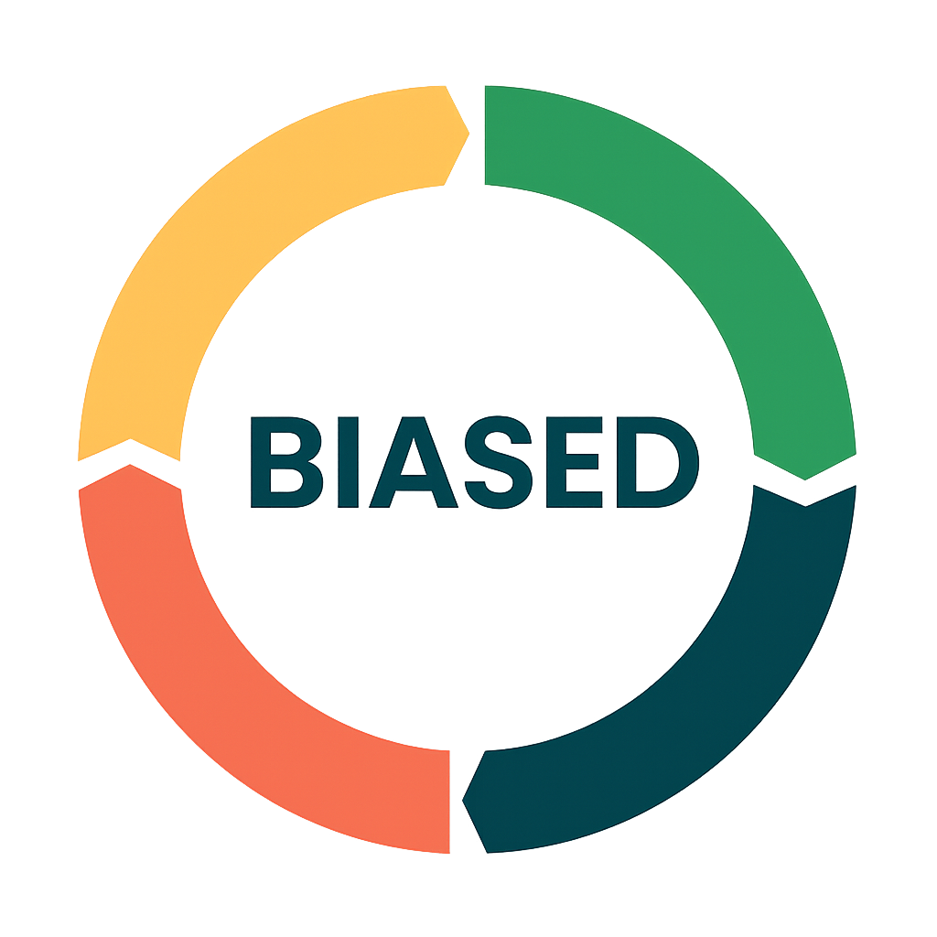
Start with Intent
Measure metrics that matter
Build alignment with intent
Operationalize Design, Performance, and Change
Integrate engineering with domain experts

Slide 12
INTENT Workshop
Outcome
Clear, shared understanding of intent (purpose, outcomes, constraints).
Translation of intent into measurable behaviors.
Alignment across domain, product, engineering, data, and evaluation.
Documents Updated
intent.md (intent statements + constraints)
behavior-spec.md (expected/unacceptable behaviors)
early metrics definitions (success criteria)
Cadence
Weekly
Also triggered when intent changes or new capability is introduced.

Slide 13

Architecture & Behavior Design Review
Outcome
Alignment on prompt architecture, RAG strategies, agent patterns, or system design.
Behavioral boundaries defined (deterministic vs probabilistic).
Feasibility review and risk reveal before the build begins.
Documents Updated
architecture diagrams, prompt/agent design docs
behavior-spec.md (boundaries, deterministic rules)
rag/data flow docs
Cadence
Weekly
Additional sessions for significant architectural changes.

Slide 14

Data & Evaluation Sync
Outcome
Understanding of model behavior through scores, drift, regressions, and evaluation trends.
Updated test sets to reflect new edge cases and real user conditions.
Identification of new data needs or pipeline adjustments.
Documents Updated
eval sets (factual, hallucination, tone, safety, drift)
drift-history.csv
weekly-metrics.json
Cadence
Weekly
Also triggered when new data sources or model versions are introduced.

Slide 15

Behavioral Demo
Outcome
Stakeholders see actual model behavior under expected inputs, edge cases, and failure scenarios.
Validation that the intent → behavior mapping still holds.
Fast feedback for iteration across product, engineering, domain, and governance teams.
Documents Updated
demo notes / behavior findings
updated behavior-spec.md
adoption feedback log
Cadence
Weekly
Optional mid-week demos for rapid iteration projects.

Slide 16


Adoption & Change Review
Outcome
Understanding user trust, friction points, misinterpretations, and real-world adoption.
Identifies need for workflow redesign, training, communication updates.
Ensures human–AI interaction is safe, clear, and useful.
Documents Updated
UX workflow maps
Comms/training/adoption materials
Escalation (Risk/Issue) logs and user override reports
Cadence
Weekly
Additional cadence when releasing to new teams or departments.

Slide 17
Security, Governance & Risk Checkpoint
Outcome
Confirm the model is secure, compliant, and meets all regulatory and policy thresholds.
Approve/block release based on risk, violations, drift, or governance gaps.
Ensure auditability, monitoring, logging, and observability are configured.
Documents Updated
governance-card.md
risk assessments
compliance logs
release notes (approved/blocked)
Cadence
Weekly
Always required before any production release.

Slide 18
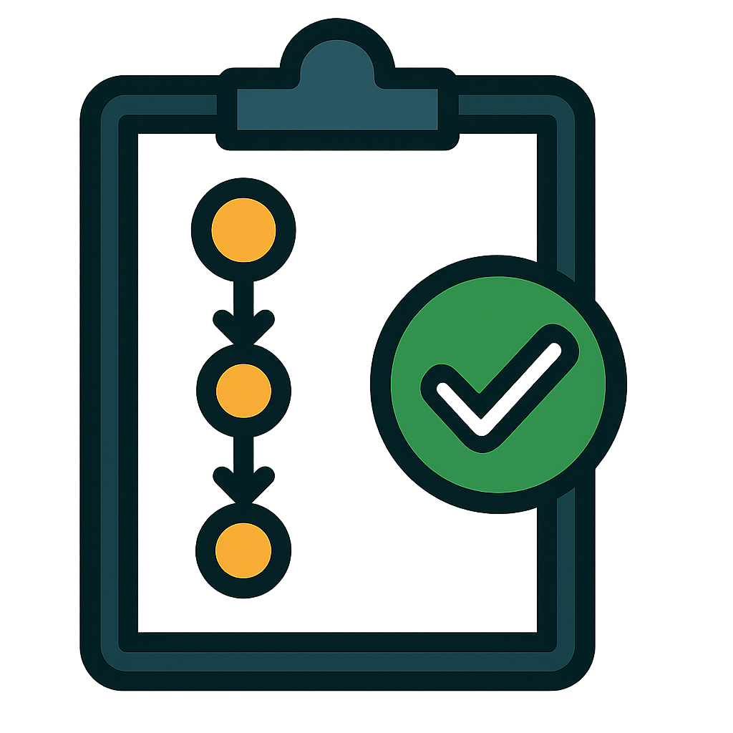
Release Decision
Outcome
A final yes/no decision for deployment based on behavior, risk, data quality, and adoption readiness.
Communicates changes and expectations to downstream teams.
Ensures nothing goes live without governance sign-off.
Documents Updated
release decision log
version tagging
deployment notes + monitoring configuration
Cadence
Weekly
Emergency releases allowed only with governance approval.

Slide 19

Metrics
Metrics are derived from AI & git commits, not Jira.
Exposes security, governance, data, and operational issues, “surprises” that are not documented today.
While measuring what matters.
Trust - Behavior & Performance
Team Maturity - Team Effectiveness & Flow
Reliability & Financial Stability - System Reliability and Cost
Customer Focus - Human-AI interaction and adoption
Maintenance Data Quality & Drift

Slide 20
Why Now?
Scrum and Kanban have not kept up with tools and processes, and AI is exposing those cracks faster.
Companies lack SDLC operating models that include product design, data, and operations.
Workforce adoption will slow AI adoption within your organizations more than a lack of data centers.

Slide 21
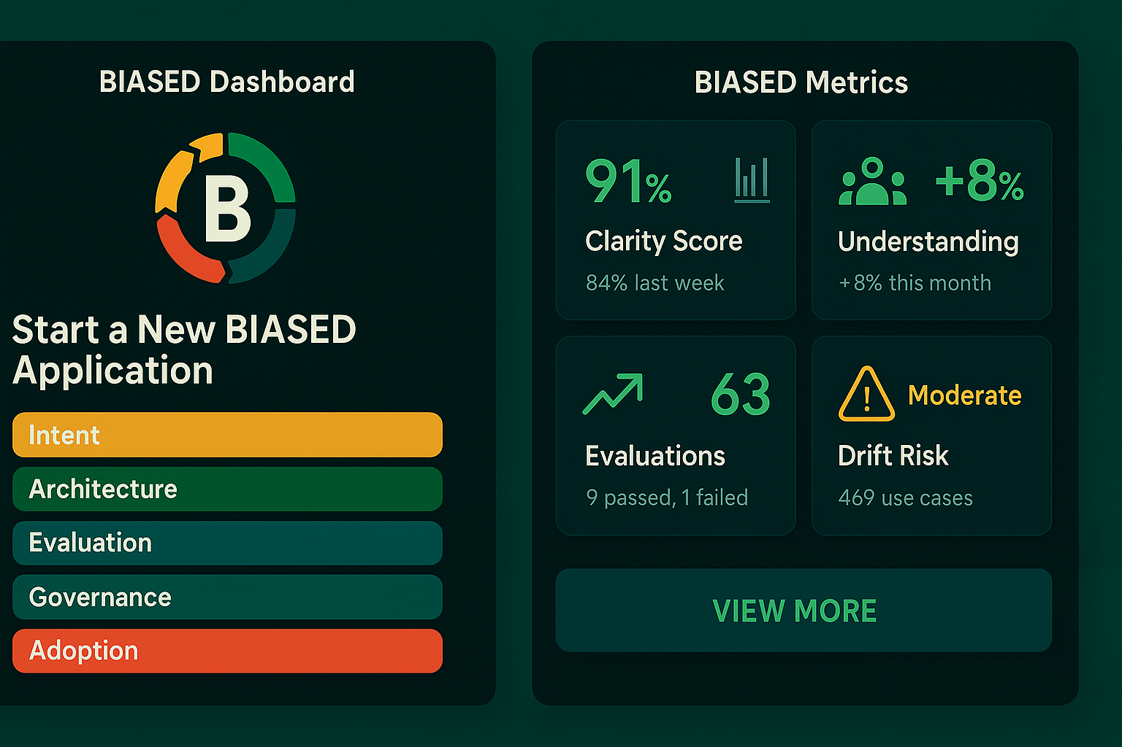
BIASED - The AI Lifecycle Operating System
Start using BIASED today
Install at the command line
# Install globally npm install -g biased-cli # Or use via npx npx biased-cli init

Slide 22
Appendix

Slide 23
BIASED
Artifacts
Measurements
Design
Security, Operations, and Governance
Data and Engineering
Adoption
All artifacts are committed to git alongside the codebase, providing version history and context for AI and team members.
Change and adoption metrics are committed directly to the codebase as markdown files, removing the need for Jira.
Designs and user interactions that determine Intent and measurements are committed directly into the codebase.
Telemetry, Security, Compliance, and Governance needs are committed in the codebase, reducing the divide between teams.
Weekly DevOps, MLOps, and AI ceremonies have documents committed to code as outcomes.
Change Management is part of the process, not a handoff.
Testing
Behavior Driven Development (BDD) & AI/ML Model Training

